Slide 1
Welcome to Coursedog, COTC’s new scheduling software.

Slide 2
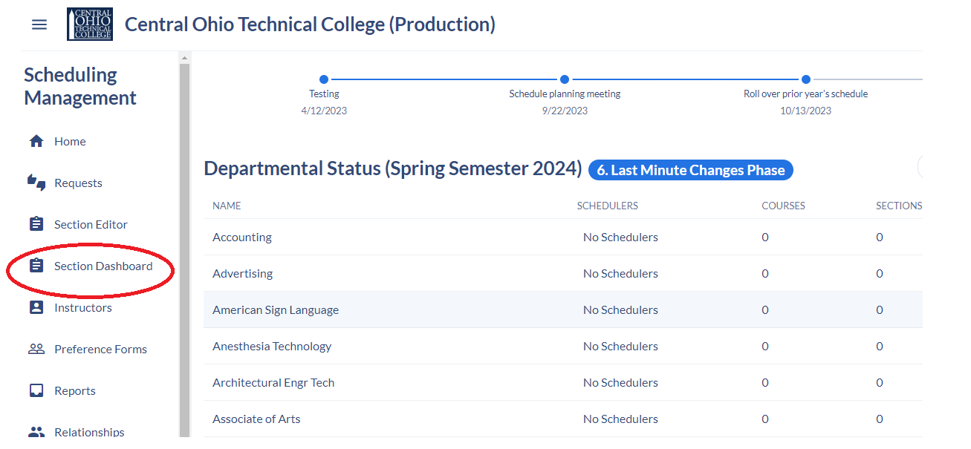
Getting started
Coursedog can be found under myCOTC; Applications; Coursedog.
You will log in with your COTC email address just using @cotc.edu (no “mail”).
You may get a generic page with this logo:
Or, you may be taken right to the following:

Slide 3
Selecting Terms
You always want to pay attention to the semester that is displayed because at any time during the academic calendar, multiple semesters may be in different phases of development.
Currently, Spring Semester 2024 is in the Last-Minute Changes Phase
Summer Semester 2024, Autumn Semester 2024, and Spring Semester 2025 are all in the Planning Phase.
To change the semester, simply click the displayed semester and select the one you want from the drop-down box.

Slide 4
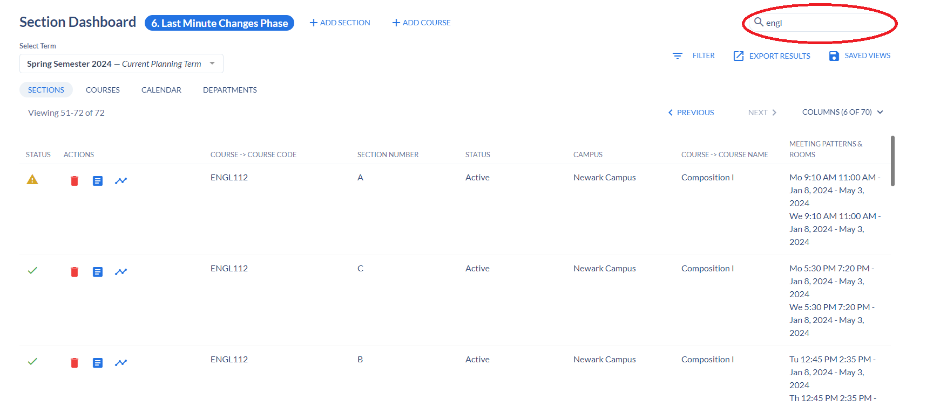
Section Dashboard
Section Dashboard will display all the sections that have been added (and cancelled/pending/held for cancellation) for the selected term. To narrow down classes, type a subject into the search bar.

Slide 5
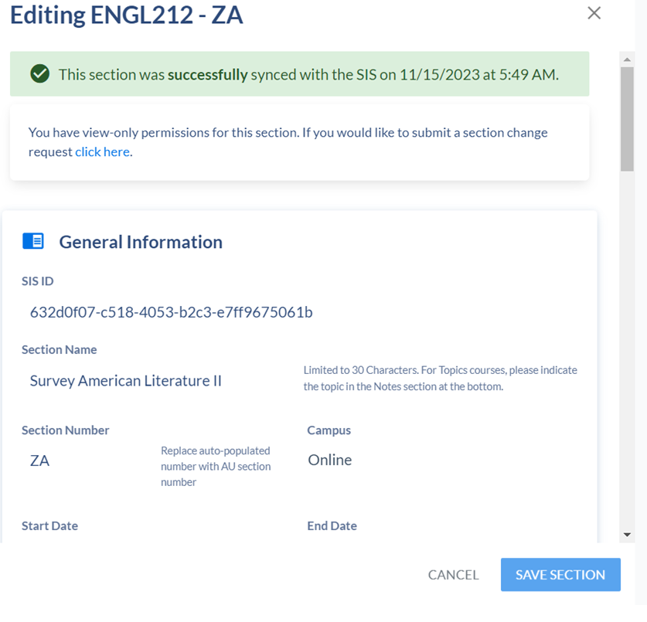
Viewing Sections
Click on any section to view the offering. You can scroll down to view all the various elements of a course section.

Slide 6
Making Changes
If everything for the section looks correct, there is no need to further action. However, if you would like to change the days, times, caps, instructional method, you can submit a request. At the planning stage, the request will go to Michelle Armas who will verify that all the needed information is provided.
Click the provided link at the top to start a request.

Slide 7
Making Changes
The following drop-down box will appear. You will always select section change and click Create Request.

Slide 8
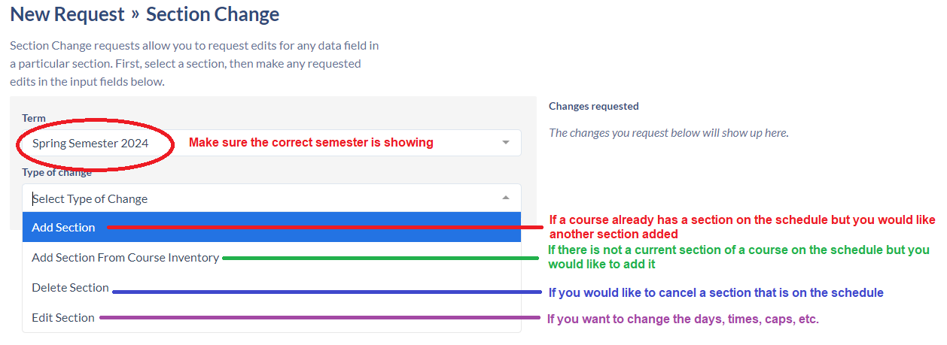

Slide 9
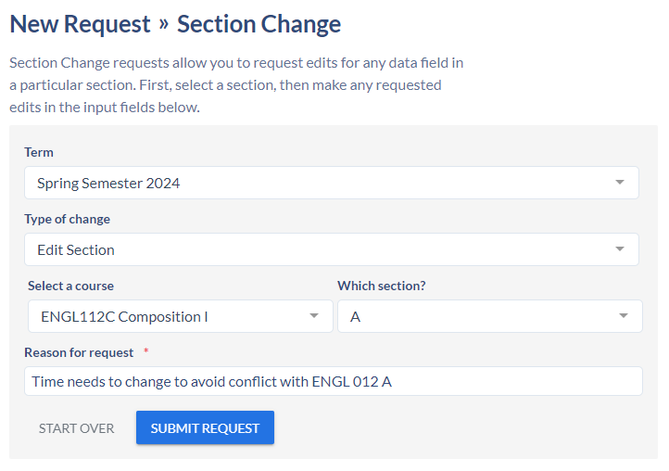
Start typing the course code for the course you want to edit. In this case, ENGL. Then select the course from the drop-down list. Next you will be asked for which section. Finally, you will be asked to provide a reason for the request. The box will expand to accommodate your answer.
DO NOT SUBMIT REQUEST YET.

Slide 10
Most edits are due to changes in days and times which can be managed under Meeting Patterns & Rooms
At this time – do not make any changes concerning instructor assignment. At this time, assignments are not being managed through Coursedog.
Simply make the changes you want, scroll back to the top and click Submit Request.
If you aren’t sure how to address a particular concern, for example you would like the lecture switched to a Zoom format, you can explain in the Reason for Request box and Michelle can make the adjustments.

Slide 11
Phases
1. Planning phase – schedule for prior academic year is rolled over. Department Schedulers review each semester and submit changes.
2. Development Phase – changes reviewed by Deans/Directors and Registrar’s staff.
3. Review Phase – review is opened for additional review by faculty/advisors. Requests will be processed through a workflow.
4. Finalize/Publish Phase – goal is to publish the entire year’s schedule by March.
5. Instructor Assignment Phase
6. Last minute changes phase – Requests can be made for errors/overlaps/room issues. Courses can be added as needed based upon demand. All require workflow and permissions.

Slide 12
Workflow
In the Planning Phase, Department Schedulers’ requests are routed to Michelle Armas to check for accuracy and then implemented.
In all other phases, requests are sent to Michelle Armas for accuracy check - routed to the appropriate dean for approval – routed to the Registrar’s office for approval and, once all approvals have been collected, the requested changes can be made.

Slide 13
Additional Help
For any questions or needed assistance, contact
Michelle Armas
Assistant Registrar – Curriculum and Scheduling
(740) 755-7356
armas.7@cotc.edu
Office: HP 139V (in The Gateway)

